Slide 1

Brain Scan AI
Project Guide
Ms. Aavani Nair
Harsh Mulik | 21107044
Tanvi Mirgal | 21107028
Sakshi Jamdhade | 21107042
Meghraj Padwal | 21107025

Slide 2
Contents
Introduction
Objectives
Scope
Features / Functionality
Project Outcomes
Technology Stack
Block Diagram

Slide 3
1. Introduction
Brain Scan AI is an artificial intelligence technology that utilizes neural imaging to assist in diagnosing brain-related conditions with accuracy
Problem Identified : Neurological disorders and brain-related conditions often require complex diagnostic processes, leading to delays in treatment and inaccurate assessments.
Solution Purpose : Brain Scan AI aims to improve the accuracy of neurological diagnoses by utilizing advanced AI algorithms to analyze neural imaging data rapidly, enabling early detection.

Slide 4
2. Objectives
To improve the early detection of neurological disorders and brain-related conditions for timely intervention.
To increase the accuracy and precision of brain scan interpretation, reducing the margin of error.
To contribute to improved patient outcomes through early intervention and optimized treatment strategies.

Slide 5
3. Scope
Brain Scan AI can be applied in the field of medicine, assisting doctors in diagnosing and monitoring neurological disorders and brain-related conditions.
Healthcare institutions such as hospitals and clinics can benefit from the implementation of Brain Scan AI to improve patient care and optimize resource allocation.

Slide 6
4. Feature /Functionality
Neural Imaging Analysis: Brain Scan AI processes neural imaging data, such as MRI & X-ray scans to extract valuable insights.
Tumor Detection: It can detect and diagnose a wide range of neurological disorders and brain-related conditions, such as tumor.
Classification: It classifies brain scans into different categories or stages of a particular condition, helping doctors make informed decisions.

Slide 7
5. Outcome of Project
User Can Sign Up and Login.
User can import an MRI image.
User will receive results classified into 4 types .
User can gain better understanding about their brain health.

Slide 8
6. Technology Stack
Google Colab notebook
Python version 3.11.5
Data set : Brain Tumor Classification(MRI) (Size:91mb)
Tensor Flow hub 0.14. 0
Tensor flow 2.13.0
Flutter version 3.3.1

Slide 9
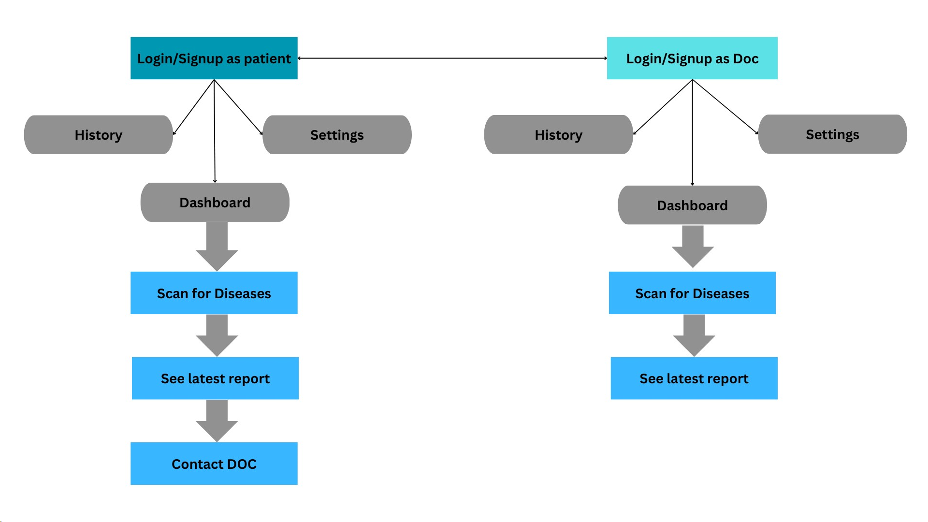
7. Block Diagram

Slide 10
Thank You...!!

